Slide 1
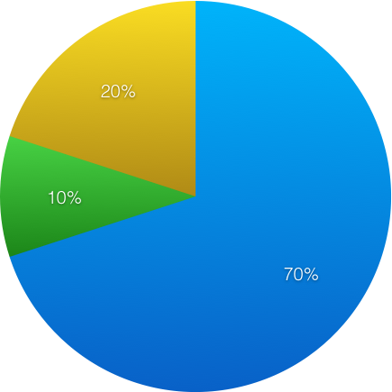
Breast Cancer Risk
10% Genetics
20% Age, family and reproductive history
70% Environmental
NIH Report on Carcinogens Twelfth Ed., 2011

